Slide 1

Module 3:
Consumer Insights and Market Positioning
This programme has been funded with support from the European Commission. The author is solely responsible for this publication (communication) and the Commission accepts no responsibility for any use that may be made of the information contained therein 2020-1-DE02-KA202-007612

Slide 2
Consumer Insights
Food innovations have high failure rates. One reason is not truly understanding what motivates consumers’ product selections.
To better understand the Senior Consumer, we need to focus on their attitudes, behaviours, expectations, and align research tactics to yield robust consumer insights, on which we can base new product development offerings.
From Module 3, you will come away with a greater insight into Seniors' food consumption attitudes & behaviours, you learn how to gain this information and apply this learning in your own business.
1
Senior Consumer Attitudes & Expectations
2
Market Research Tactics
3
Using this Information to Market, Brand, and Innovate more Effectively
4
Resources

Slide 3
1
Senior Consumers'
Attitudes & Expectations

Slide 4

Before we go on, the senior market can fall into the category of potentially vulnerable consumers. A vulnerable consumer could be defined as:
“A consumer, who, as a result of socio-demographic characteristics, behavioural characteristics, personal situation, or market environment:
Is at higher risk of experiencing negative outcomes in the market;
Has limited ability to maximise his/her well-being;
Has difficulty in obtaining or assimilating information;
Is less able to buy, choose or access suitable products; or
Is more susceptible to certain marketing practices.” Source: EU Commission Factsheet
A very interesting read!

Slide 5

Where to start…
For food producers, it can be challenging to produce new and healthy products and services, specifically for older people. What are the preferences and expectations of consumers in this segment? What factors influence their decisions to purchase new healthy food products?
In order to gain a better insight into Seniors’ food consumption attitudes, expectations, and behaviours, we have researched and summarised four key research studies that have been carried out across the world that aimed at the senior consumer market.

Slide 6

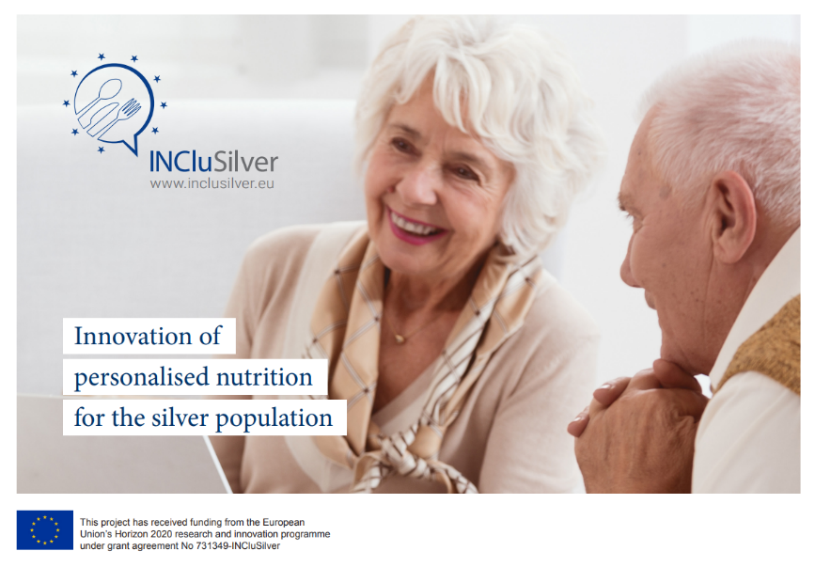
1. Market analysis in the silver economy via the InCluSilver Project
Findings:
Elderly nutritional needs should be well communicated to the population. In 2050, the European population is expected ~33% of individuals will be >65 years old. As people are healthier and more active now, their expected lifespan also increases. Therefore, the market for personalised nutrition for older people should grow too. However, it was found that geography plays a major role in their purchasing power.
An obstacle is that ageing adults are not aware of their nutritional needs and are therefore reluctant to use products labelled as “elderly food”. These are currently viewed as food for sick people when they are still ‘young’ and active. However, finding a way to increase their knowledge in nutrition for the elderly, there is an open market waiting to be invaded.
Source: Etude de marché (inclusilver.eu)

Slide 7

Key Findings…
The market analysis study and interviews performed by INCluSilver have suggested some strategies/ recommendations that could be developed by SMEs to successfully enter the market segments related to elderly-dedicated food products or services:
Target specific consumers/segments (e.g., based on age or location)
Aim to be supported by partnering companies or clusters (e.g., via a network, complementary companies, or B2B distribution scheme) to enter the market
Prescribers are essential in the access to the elderly-dedicated food market (e.g., doctors, dietitians, or local organisations/government authorities)
Food products targeting the care home market segment has fewer barriers to entry.

Slide 8

2. Study based on Age…
An insightful study analyses consumer decision-making strategies according to age ranges, noting their preferences for novel food products. Utilising means-end chain theory, the study claims that innovation success is a combination of:
understanding consumers, the features and benefits they are seeking in the products they purchase and consume; and
understanding the aspects of their personalities that they project through product usage
The results show age is not a factor in consumption decisions with familiar products.

Slide 9
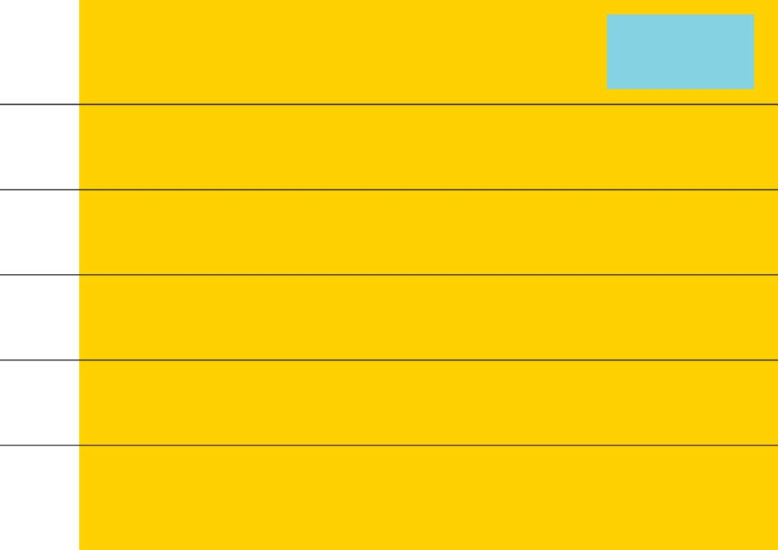
Means-End Chain Theory (MEC)
“MEC is a cognitive structure* that links consumers’ knowledge of products to their knowledge of certain consequences and values connected with those products.”
“The main premise of MEC is that consumers learn to select products that feature the attributes which allow them to achieve their desired ends ... MEC theory assumes that people base their purchase choices not on the products themselves but on the benefits to be gained from their consumption.”
Terminal Values
Give me a sense of social belonging
LEGEND
Attributes
Consequences
Values
Instrumental Values
50%
57.1%
Provides fun, pleasure and enjoyment
Enhances my quality of life and security
78.6%
50%
71.4%
50%
Psychological Consequences
Gives me a sense of cultural identification
Makes me feel more cosmopolitan
Provides me with happiness and satisfaction
I’m consuming a quality product
No health risk
92.8%
71.4%
Good eating habits
Functional Consequences
I’m well informed
Appetizing and enjoyable to drink
64.3%
It is a healthy food
It is familiar
64.3%
It saves me time
Abstract Attributes
50.0%
57.1%
92.8%
85.7%
66.7%
Quality
Ease of preparation
71.4%
* Big Word made simple: Cognitive structures are the mental processes that individuals use to process and understand information.
Concrete Attributes
Label information
Taste
Aroma
Brand
Level 6 Hierarchical Value Map for the Adult Group and Coffee Capsules (Regular consumption).
Source: Barrena et al., 2015

Slide 10
3. Health-Belief Model (HBM)
Another study seeks to broaden our understanding of older adults' intention to consume functional food. Importantly, this study is one of the first studies that extend the application of the Health Belief Model (HBM) in the context of functional food consumption.
The results show that perceived barriers and cues to action significantly affect older consumers’ intention to consume functional foods.
Nevertheless, perceived susceptibility does not influence older consumers’ intention to consume functional food.
“HBM explains the relationships between health beliefs and health behaviours based on the assumption that preventive behaviours can be formed by personal beliefs. HBM considers behaviour as a function of the knowledge and attitude of an individual.”

Slide 11



Health-Belief Model Findings…
Perceived susceptibility describes the “belief about the chances of experiencing a risk or getting a condition or disease”
Perceived barriers: belief about the tangible and psychological costs of the advised action
Cue to action: strategies to activate readiness
Perceived Susceptibility
Consumption Intention of Functional Foods
Perceived Barriers
Cue to Action

Slide 12
Health-Belief Model Findings…
Key take-aways from this study:
Perceived susceptibility is not relevant for functional food consumption.
Humans do not always act rationally, they are aware that functional foods could improve their health, however, they do not necessarily want to consume them.
Scaring older consumers into eating healthier is therefore not the route to follow.
Companies should aim to keep perceived barriers low (e.g., the taste of the food, or difficult packaging).
Offering older consumers a cue to action can be important during marketing e.g., encouraging seniors to eat functional foods through prompts from their children.

Slide 13
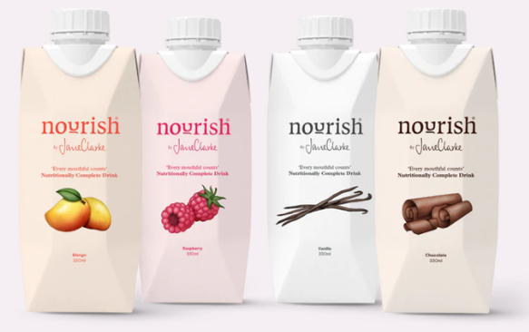
Be Inspired…
4. A study on older adults packaging interactions…
This UK-based company NOURISH is a great example of a business considering consumer vulnerability via their product and packaging. All interactions are addressed in the following ways:
1. Online sales, which eliminates travel and transporting the goods.
2. Tetra packed for easy storage and in 330ml size, which can be consumed on the day of opening.
3. Easy grip and twist-off cap with wide spout to avoid messy pour and closure.
4. Easily disposed of (i.e., Rinse & Recycle)
This study explores the concept of consumer vulnerability in the context of older consumers’ packaging interactions.
The findings reveal that changes due to multiple dimensions of ageing can increase older consumers’ risk of experiencing vulnerability during packaging interactions. The study provides new insights to help companies empower older consumers through packaging development, thereby reducing their consumer vulnerability.
Meal Replacement Drinks - Nourish by Jane Clarke

Slide 14
This study illustrates the variety of consumer-packaging interactions across the packaging journey, highlighting the following stages:
4
6
Opening
Reclosing or putting away
Point of sale
Transporting the product home
Serving the product for consumption
Home storage
1
Disposal
2
5
3
7

Slide 15
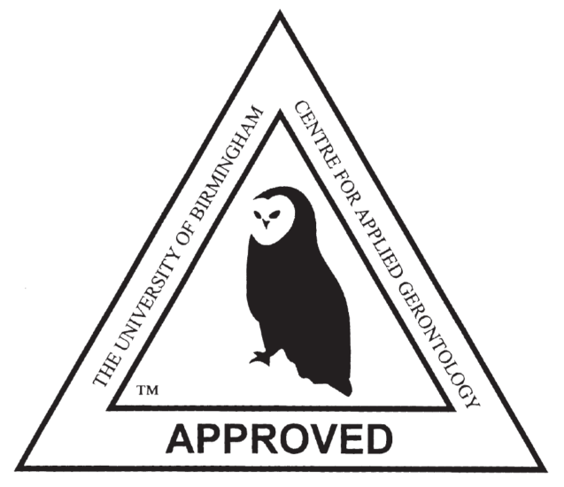
Key take-aways from this study…
Create packaging to alleviate the ‘vulnerability’ experience of older consumers.
Products positioned clearly towards the senior market may discourage older consumers who do not wish to purchase products that label them as ‘old’
A proposed solution could be: Inclusive design
Try to achieve a balance between communicating the functional benefits of the products to those consumers who will receive the greatest benefit (e.g., older adults), whilst maintaining a mass-market appeal
Encourage consumers to purchase larger/heavier items online through consumer education programmes
Dedicate space in stores for value-adding facilities which encourages social interactions (e.g., delicatessen counters)
Example: ‘Owl Mark’ created by The Centre for Applied Gerontology at the University of Birmingham. It is a quality mark which accredits products as suitable for older people’s needs

Slide 16
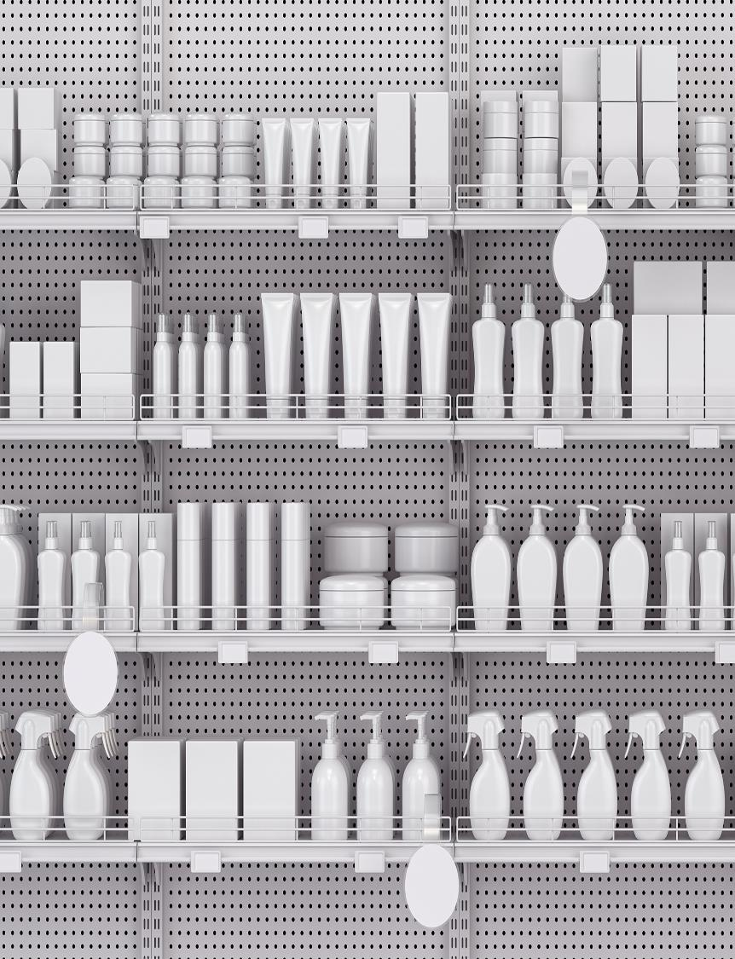
“
Well-designed packs make for attractive, eye-catching products that consumers will want to buy again. Such packs enhance and add value to the contents. Conversely, poor packaging can instill feelings of anger and frustration that will far outweigh any virtues that the contents may have.
”
Source: Galley (2005)

Slide 17

Immerse yourself in knowledge
In this section, we have summarised four key studies. By using design thinking principles (developing empathy - Module 1), we are endeavouring to learn from those within the senior market by testing ideas with them, observing them, and noticing the differences. Then, by synthesising and deciphering this information, we discover insight and opportunity within!!

Slide 18
Summary of key insights:
Maintaining an autonomous life can be seen as a primary goal for older adults. Create products that support and keep autonomy in mind at every design step. (e.g., simple packaging, nutritional enrichment, home delivery service).
Create products to solve the problems seniors are experiencing, but do not emphasise the (health) problems in your communications with clients. Do not tell seniors they cannot work independently anymore and do not label them as old.
Keep the perceived barriers low and make your product easy for everyone to access and use. If there are barriers in the packaging (needing scissors to open/ too heavy to carry home) or positioning (top shelf of the supermarket), your product will not be popular with seniors because they may experience moments of vulnerability when trying to use it.
There is a general skepticism about functional foods and one tactic is to enrich more traditional meals to appeal to these older adults and their tastes.
Carry out customer research, preferably qualitative research (i.e., interviews), on the specific needs of the older adult market you are targeting.

Slide 19
2
Market Research Tactics

Slide 20

Why we research the market?
Market research leads you to the
insights you need to grow. It provides
companies with relevant data, thereby helping to make more
informed decisions. No matter what
your brand is, market research is
crucial. Without market research,
it can feel like you are promoting your brand, product or service blindly.
But with it, you can identify key
demographics, learn more about your buyers and implement tactics in a more accurate and successful manner.

Slide 21
The types of Market Research
EXAMPLES OF RESEARCH METHODS
SURVEYS
1. PRIMARY:
Primary Research is research done by you or your business. All data in Primary Research comes from your sources. (Field Research)
2. SECONDARY:
Secondary Research is research that is not done by you but is from an existing study. (Desk research)
FOCUS GROUPS
OBSERVATIONS
PILOT TESTING
SOCIAL MEDIA ANALYTICS

Slide 22







Click on each of the logos for more information on each of the following commonly used Survey Software…
1. Surveys…
Using surveys in your market research allows you to collect insights throughout the product or market lifecycle. Explore prospective and existing customers’ needs and motivations, positive and negative feelings about your products or branding, and the effectiveness and reach of your promotional efforts.
Most surveys are carried out online these days with great analytic capabilities and reporting functions

Slide 23

2. Focus Groups…
A focus group is a market research tactic (qualitative) used to discover consumer attitudes towards a product, service, or campaign through a moderated conversation amongst participants. In contrast to individual interviews, this research is conducted in a group format, with a trained facilitator present to direct the discussion.
Focus groups are usually conducted on behalf of a business, with the help of a market research firm. Good market research companies specialise in recruiting, conducting, and evaluating focus groups, using tactics and knowledge gained through years of industry experience.

Slide 24

3. Observations…
Observation is a market research technique in which highly trained researchers generally watch how people or consumers behave and interact in the market under natural conditions.
It is designed to give precisely detailed and actual information on what consumers do as they interact in a given market niche.
You can use observational research when questions such as 'How?' or 'What?' need to be answered from the research. This type of research /tactic is useful when the research topic has not previously been studied and there is very little known about typical behaviours in the particular setting.

Slide 25

4. Pilot Testing…
In pilot testing, you elicit the help of a few users or consumers to test your product or service before you launch. This allows you to see what is working and what’s not. Once you have conducted pilot testing and have received recommendations and feedback you get the opportunity to adapt or alter the product or packaging etc. based on what the consumer highlighted. This is both a cost and time saving exercise and again is a distinct phase in the Design Thinking Process (Module 3)

Slide 26

5. Social Media Analytics…
Social media analytics is the process of collecting and analysing audience data shared on social networks to improve a company’s strategic business decisions.
Social media can benefit businesses by enabling marketers to spot trends in consumer behaviour that are relevant to their sector and can influence the success of marketing efforts.

Slide 27
By gathering a wide variety of market data, it will help you develop a solid branding and marketing strategy.
MARKET DEFINITION
MARKET SEGMENTATION
MARKET POSITIONING
CUSTOMER MANAGEMENT
Defining your market can provide different perspectives from customer-based markets to competitors-based markets & thus can identify opportunities and threats.
Markets are complex ecosystems, and knowledge of your market is what drives market performance and profitability. Evaluating segmentation variables can enhance competitive advantage and profitability.
A strategic market positioning is essential to gain a sustainable competitive advantage and ensure long-term profitability of a company. You need to serve customers’ needs better than competitors.
Behavioural analysis plays a vital role in understanding who your customers are and their needs. Buying decisions are made in different stages and typically involve multiple players. By leveraging customer behaviour data, you can determine your market segment and refine your marketing message/channel.

Slide 28

1. The Starting Point, defining your market
We know that we want to solve problems for the Senior Market.
We are aware of their problems as we develop customer personas. (See Modules 1 and 2).
Seniors could be seen as our ‘niche’ market, but we know this is a growing market.
Through completing our course, you are currently developing your expertise in this market.
An important consideration though, is that you also need to know who your competitors are!

Slide 29

2. Market Segmentation - Categorising Seniors into ‘Boxes’
The heterogenity in demand is not only caused by the physiological deterioration of the human body, socio- and demographical statistics also play a role. The largest separator of demand is the income level.

Slide 30
Why do we divide the MARKET?
In marketing, market segmentation is the process of dividing a broad consumer or business market, normally consisting of existing and potential customers, into sub-groups of consumers (known as segments) based on some type of shared characteristics.
In dividing or segmenting markets, researchers typically look for common characteristics such as shared needs, common interests, similar lifestyles, or even similar demographic profiles. The overall aim of segmentation is to identify high yield segments – that is, those segments that are likely to be the most profitable or that have growth potential – so that these can be selected for special attention (i.e., become the target markets).
Control in the market
Market Segments
Targeting
Positioning
Creating
Implementing

Slide 31

Market segmentation assumes that different market segments require different marketing programmes – i.e., different offers, prices, promotion, distribution, or some combination of marketing variables.
Market segmentation is not only designed to identify the most profitable segments but also to develop profiles of key segments in order to better understand their needs and purchase motivations.
Insights from segmentation analysis can be used to support your marketing strategy development and planning for the senior market.
Understanding the Consumer / Market?
Identify the customer & their needs / segment
Create specific marketing strategy
Good market positioning

Slide 32




The Senior Market Segmentation
Geographics
Demographics
Psychographics
Behavioural
Region
Country
Urban / Rural
Density
Language
Climate
Age
Gender
Income
Education/ Occupation
Social Status
Family / Life stage
Lifestyle
Beliefs / Opinion
Concerns / fears
Personality
Values
Attitudes
Benefits sought
Purchase habits
Usage
Intent
Occasion
Buyer stage
Engagement

Slide 33
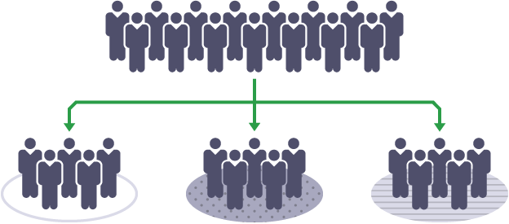
Location:
Splitting up a market by location is also known as geographical segmentation. This is used to split up a target market based on where people live. A business may choose to target customers in its local area or consider what types of products would sell in specific locations.
For example, the production and delivery of fresh meals to older adults may be only regional.

Slide 34







Demographics:
Age
Social Status
Demographic segmentation
considers the characteristics of people. These characteristics may include age, gender, race, religion, nationality, disability, ethnicity, sexual orientation, and occupation. Consider the demographics of the people to whom you want to aim your products.
By aiming your food products at older adults, age and income are the two most important factors to consider.
Gender
Income
Education
Occupation

Slide 35




Psychographics:
"Psychographics are about using the demographic information you have for your customer persona, to figure out more about their lifestyle, their behaviours, and their habits."
- HubSpot
Psychographics is the study of personality, values, attitudes, and lifestyles. Psychographic segmentation involves dividing a market into segments based upon different personality traits, values, attitudes, interests, and lifestyles of consumers. This form of segmentation is advantageous because it helps businesses like you, engage better with your customers, design more suitable products and improve marketing in a focused manner. Some older adults may be quite active and open-minded to trying new products while others may have a closed attitude.
Activities & Interests
Attitudes & Personality
Values &
Beliefs

Slide 36

Behavioural:
Purchasing Behaviour
Of all of the segments we look at, it is probably most advantageous for food businesses to look at consumer behaviour, so they can better understand:
the decision behind why senior customers purchase certain products
what influences seniors to make those purchasing decisions
This tactic is used to understand and gain insight into the customers' decision-making process, so you can better tailor the company's marketing, branding, packaging strategy to meet the seniors’ needs.
This supports actionability and stability in your product planning and marketing!
Customer Journey Stage
Occasion or Timing
Behaviour Segmentation
User Status
User Rate
Loyalty
Benefit sought
Be aware of the different types of consumer behaviour, such as:
Routine/Habitual purchasing
Promotion purchasing
Informed/investigative purchasing
Impulsive purchasing

Slide 37

Which MARKET SEGMENTS do you TARGET?
We have just discussed the usual segments of a typical market. However, studies show that segments 1 to 3 (Geography, Demographics, and Psychographics) provide descriptive data on “after the fact” customer characteristics. However, we want to learn and understand what causes seniors to make purchases!
We know that Product Design and Communication are helpful tools to enhance the appeal of products, especially for functional foods and so we can now categorise the four segments into two groups:
A Preference-Based Segmentation – which could be predictive of behaviour (attributes and benefits sought)
A Characteristic-based Segmentation – which would consider demographics, environment, physiology etc. of the market

Slide 38
Going from Segments to Target Groups…
Buyer preferences and behaviour are constantly evolving, so it’s more important than ever to be operating from the most recent, relevant picture of your target older consumers.
It is important to gather insights to understand this preference-based segment e.g.,:
Measure product demand to determine which segments would be most likely to purchase your product → indication of market size
Develop a deep understanding of your buyer personas, their preferences, and behaviours → indication of growth & profitability potential
Guide campaign targeting by learning which segments would respond the best to marketing → indication of market acquisition costs

Slide 39
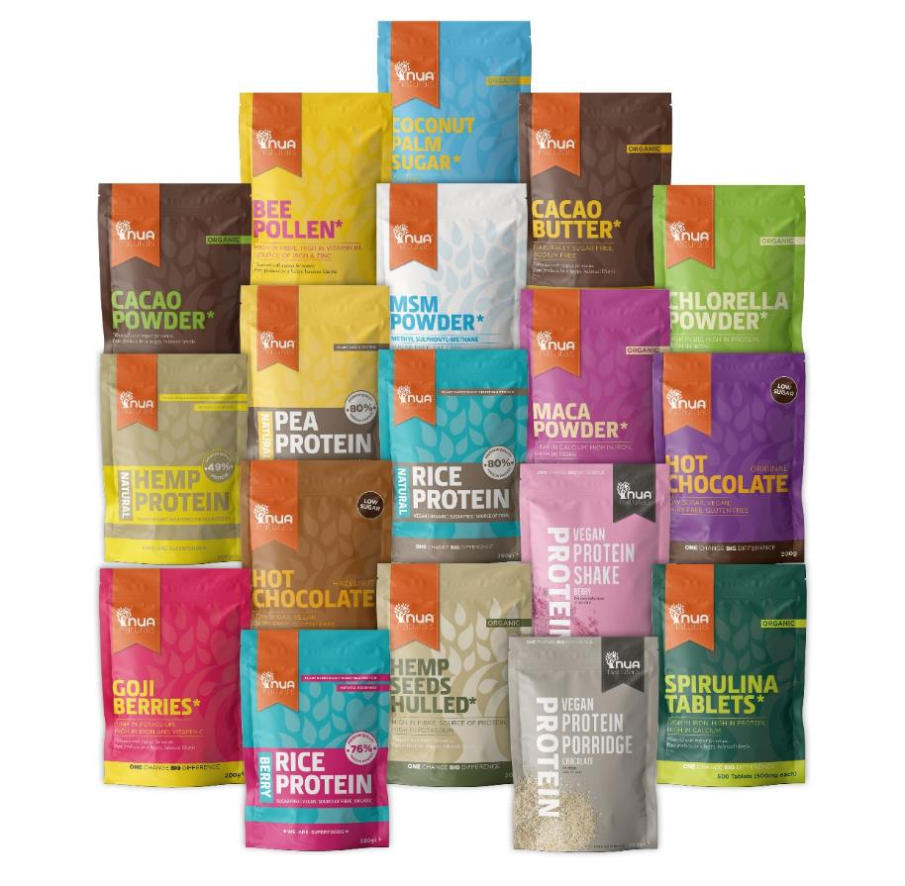
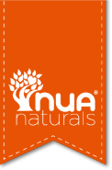
Preference-based…
Studies show that seniors aged between 60 and 69 value the product quality more than the price point and expect a broader choice of products when shopping for healthy food products. Source
A 2018 study showed that older consumers have specific preferences regarding packaging type and design. Simple graphics and font as well as subdued colours positively affected their reception of the product. Source
LINK
One of our Good Practice Case studies demonstrates how they achieve these marketing goals…Quality – Choice - Good Packaging

Slide 40
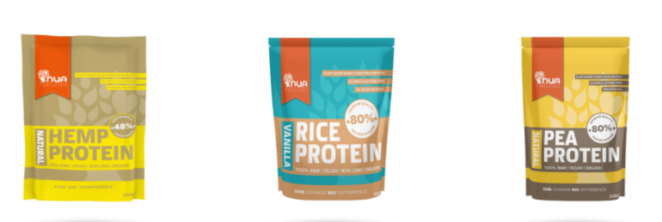
Be Inspired….
NUA Naturals is a market leader in enhancing health and well-being with its delicious range of Organic Natural Superfoods. Their mission is to create a healthy, happy balance for body, mind and spirit for all ages.
Although Nua Naturals don’t specifically target the senior market, their products are ideal for this market segment. While these super-food powders can be added to liquids, pastes, or foods and enhance the nutritional value, they also help supplement seniors' diets easily and combats the challenges of malnutrition and swallowing issues.
Nua Naturals demonstrates how they are meeting the senior consumers' needs by providing high quality and a broad choice. They also show how they are considering the importance of packaging for seniors…by providing lightweight, easy-to-read font, easy-to-store, and easy-to-open pouches and tubs.
Interestingly, there is no segment-specific wording and they have created a universal product that happens to suit the senior market!!

Slide 41
3
Using this Information to Market, Brand, and Innovate more Effectively

Slide 42


The STP Model
Segment
Up to this point, we have been following the STP (Segmentation, Targeting, and Positioning) Model, which helps you position a product or service to target different groups of customers more efficiently.
The next step is to use the information we have gathered to position your product development motivation (filling a gap or meeting expectations /preferences) in the senior market.
Target
value
Position
Poor taste
Good Taste
low value

Slide 43


The STP model in more detail
Segmentation + Targeting → Positioning
The STP model is more user-centric than product-centric. Therefore, the model creates a higher level of RELEVANCE TO BUYERS.
This Video by the Brand Master academy gives an overview of what STP marketing is with examples of each stage.
STP Marketing Explained (Segmentation, Targeting & Positioning Examples) - YouTube

Slide 44
Exercise:
Create a Positioning map for one of your product ideas...
Please find a video link to S-T-P - Positioning - YouTube to assist you in this exercise.
Remember to label your axis correctly. We created this table of Axis titles to offer you a few suggestions…
1. LOW VOLUME | HIGH VOLUME
2. HEAVY | LIGHT
3. NECESSITY ITEM | LUXURY ITEM
4. SIMPLE | COMPLEX
5. UNHEALTHY | HEALTHY
6. DIFFICULT TO USE/OPEN | EASY TO USE /OPEN
TIP: While carrying out this exercise, think about your senior audience and what might motivate them!

Slide 45
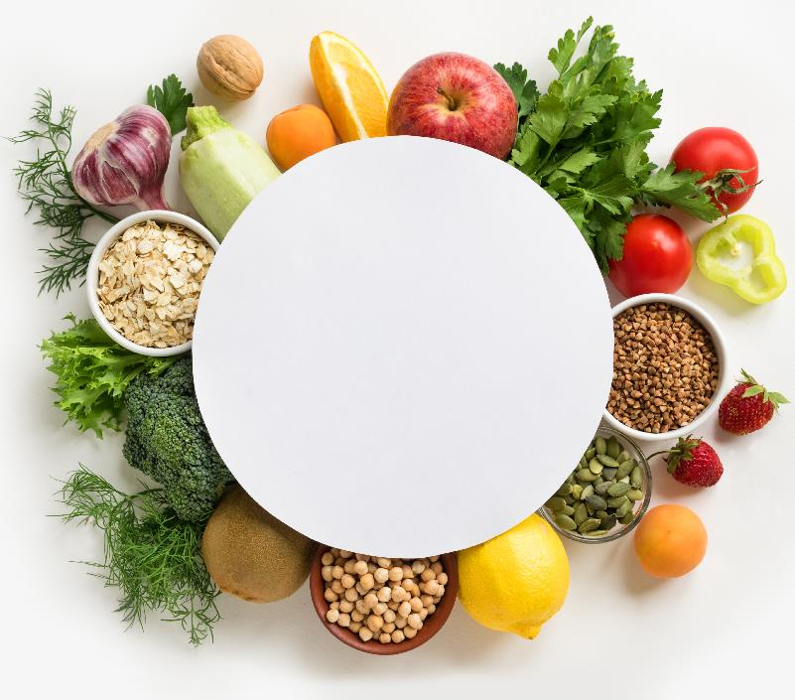


Getting into position!!
Segmentation: this is where you get to know your customers. It is the process by which you understand why they would purchase your new products.
Targeting: this is the act of increasing your market relevance. It is the process by which you assess which people you can best satisfy with your products and services and how you can make yourself irresistible to them.
Positioning: this is the act of locating yourself appropriately. It is how you arrange yourself for the market based upon your findings in the earlier stages. Consider the relative pros and cons of the market you intend to enter and question whether this market is aligned with your current goals – put simply, is this target market worth your efforts?

Slide 46
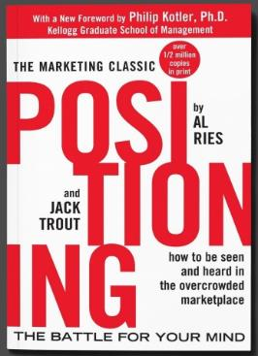
"Positioning – The Battle for Your Mind" was first published in 1981, by Al Ries and Jack Trout. It was one of the earliest books to look at the problem of how one makes a brand stand out in a modern world that’s saturated with competitors, and to consumers who have grown skeptical because of media bombardment. It’s a problem that’s more relevant today than ever.
The Positioning concept, which changed the nature of advertising, can affect the product, its price, place of sale, and its promotion.
As the title indicates positioning is all about consumers’ perceptions and how you can improve your ranking in their minds.
Market positioning:
We have discussed consumer perceptions and preferences.
Market Positioning refers to the ability to influence consumers' perception regarding your brand or product relative to competitors.
The objective of market positioning is to establish the image or identity of a brand or product so that consumers perceive it in a certain way.

Slide 47
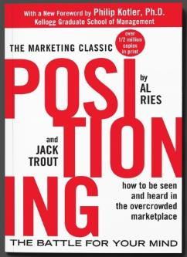
Main takeaways from: "Positioning – The Battle for Your Mind"
TIP: Food Businesses should consider these ideas when developing new products for the senior market
Positioning consists of seeking the solution in the mind of the potential customers
To be successful, it is necessary to have successful communication to penetrate people's minds
The mind has no room for the new unless it has a connection with the old
The positioning of competitors cannot be ignored
The easiest way to penetrate the customer's mind is to be the first
The following brands must look for loopholes in the customers' minds
The name is essential and can influence the failure or success of a product
Approach product line extension with caution and use readily-known names in new products
A positioning programme requires a solid long-term commitment of the people in charge of it.

Slide 48
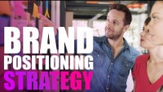
Brand Positioning Strategy…Giving Your Audience Something Different
Learn from Brand Master Academy about how to create a brand positioning strategy using an 8-step brand strategy process framework. Also, learn how to stand out from your competitors and offer your audience something different.
How To Create A Brand Positioning Strategy - YouTube

Slide 49

An 8-step Positioning Plan…
Identify your Target Market
Identify your Competitors
Conduct Market Analysis and Competitor Research
Identify Gaps and Opportunities
Uncover your Differentiator*
Write a Brand Positioning Statement*
Create a Communication Framework*
Design your Brand Experience
* Big Word made simple: A Differentiator is a characteristic of your food company or product that separates you from key competitors and gives you a perceived advantage in the eyes of your target audience.
* A Brand Positioning Statement is a brief description of a product or service and explains how it fulfils a particular need of the target market. A positioning statement aims to align marketing efforts with a company's brand and value proposition.
* A communication framework consists of an overview of how you plan to communicate internally and externally in your company. It would include identifying your audience, objectives, messages, channels, and how you would measure success.

Slide 50






The Anatomy of a Brand Positioning Statement
Your target audience
The unique value your brand brings to customers
The industry/space your brand operates in
(i.e., food for seniors)
How your brand meets your customer’s needs
Positioning statements are internal tools that help marketers appeal to their buyer personas relevantly. They are a must-have for any positioning strategy because they create a clear vision for your brand!

Slide 51
Exercise:
Draft your positioning statement. Use our templates provided to assist you in this exercise.
Once you have completed the draft, it is easier to adjust your tone and edit accordingly.
Positioning statement templates:
Template 1
For [target market] who [statement of need] the [product or service] is a [type of product] that [key benefit]. Unlike [primary competitor], our product [differentiation statement].
Template 2
For [target market] the [brand, product, or service] is the [differentiation statement] among all [type of product] because [key benefit].

Slide 52
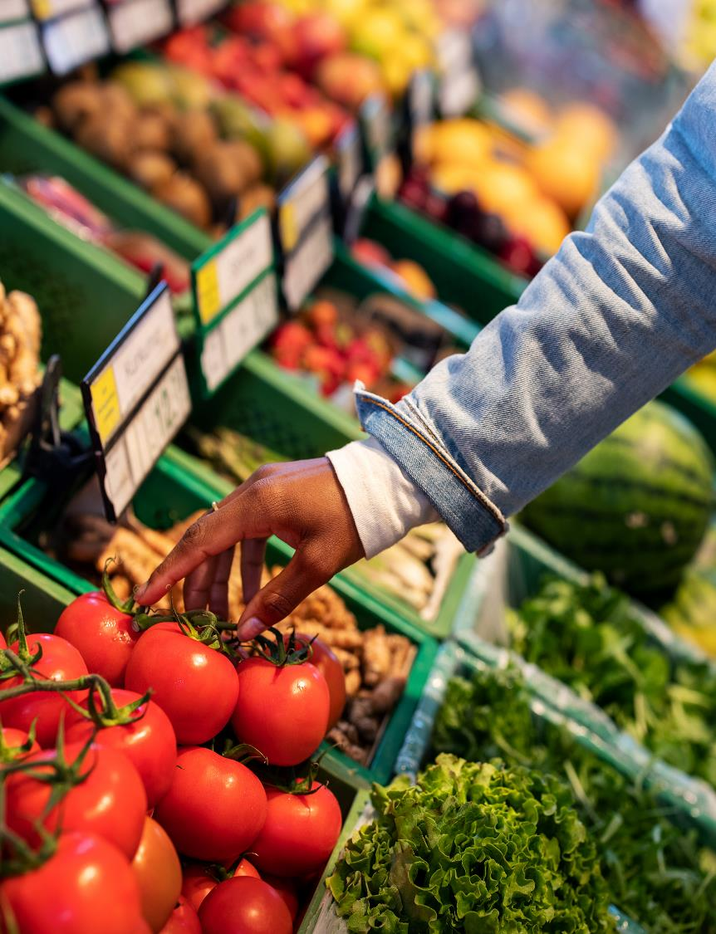
An example of positioning statement would be:
Biozoon are leaders in smooth-food products and offer persons who cannot eat and drink normally the opportunity to taste and experience foods that they may not be able to enjoy due to dysphagia and other medical issues, including being nil
by mouth.
“
”
Source: Biozoon

Slide 53

Market Positioning refers to the ability to influence consumer perception regarding a brand or product relative to competitors. The objective of market positioning is to establish the image or identity of a brand or product so that consumers perceive it in a certain way.

Slide 54
Understanding the differences…
Positioning Statement Vs. Mission Statement:
A mission statement is the purpose(s) your business serves in the market — it is an inherent part of the organisation that guides every business function. When considering the “what, why, and how” of your business, a mission statement answers the question “why”, while the positioning statement answers the “what.”
(Unlike a mission statement, a positioning statement is not public-facing.)
Value Proposition Vs. Positioning Statement:
A value proposition describes what sets your product or service apart from competitors. It gives an overview of the benefits a product or service provides. A positioning statement is broader and is created after you've developed your business' value proposition. It also identifies the primary customer benefits — why someone needs your product or service.
Source

Slide 55

How to use market positioning in marketing strategy…
Businesses use marketing to create value for customers by making two key decisions:
Decision 1:
Which customers to serve?
Decision 2:
How to serve those customers?
Market Segmentation
Targeting
(deciding which segments to enter)
Product differentiation (what makes it different from the competition)
Market positioning
(how customers perceive the product)
How to compete in those segments…is the value proposition. What position will be taken?
The value proposition is defined by the customers – the place a product occupies in customers' minds relative to the other competing products.

Slide 56
And now to Branding
Branding is the practice of differentiating your business from another through a name, logo design, story, message, etc. in customers' minds in the market.
Branding is a tactic to help the customers in the market quickly identify your brand, its offerings, and overall experience giving them a reason to choose your company's offerings and not of the competitors. It helps to give a competitive edge and advantage to your company.
The main objective of branding is to attract and retain customers by delivering product and service offerings that are aligned well with the promises made by the brand.

Slide 57

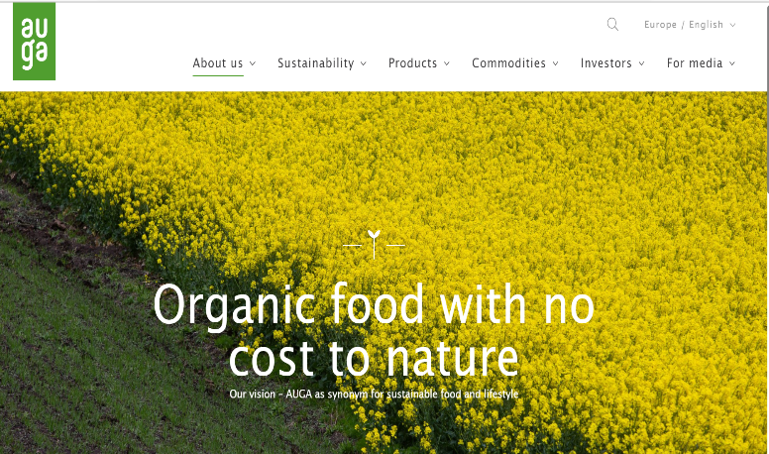
Be Inspired…
LINK TO GP GUIDE
Branding is not merely the design behind your company. In fact, you cannot design a brand. Creating a logo design and visuals is part of branding, but first, you need to define your brand values and identity, voice, and personality.
AUGA is one of our good practice examples where their brand values & identity are well-defined and are consistent with their message and voice across all media, i.e., their products, website, social media and publications.

Slide 58
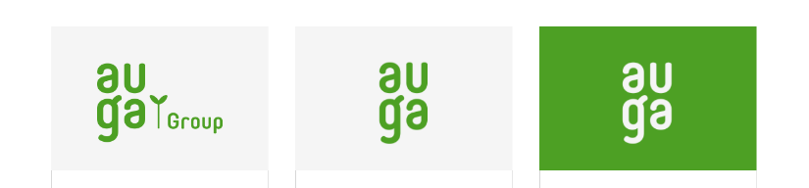
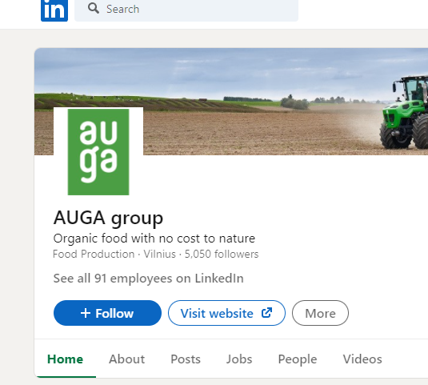
AUGA and their Logo…
All versions of their logo portray a simple message - Clean and Green, giving consumers a clear insight into their values and ethos. They use a tagline to emphasise this…
“Organic food with no cost to nature”
This tagline is used across all social media platforms as you can see here on their LinkedIn Page.

Slide 59

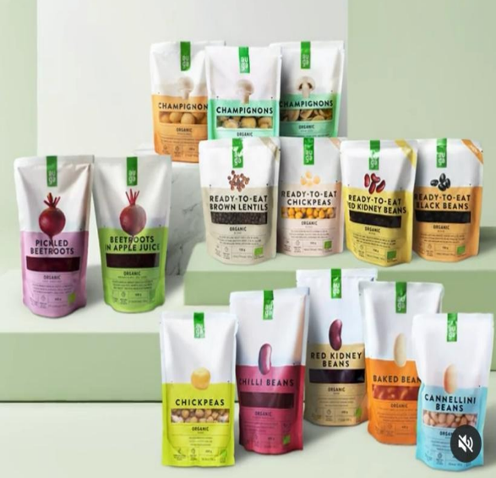
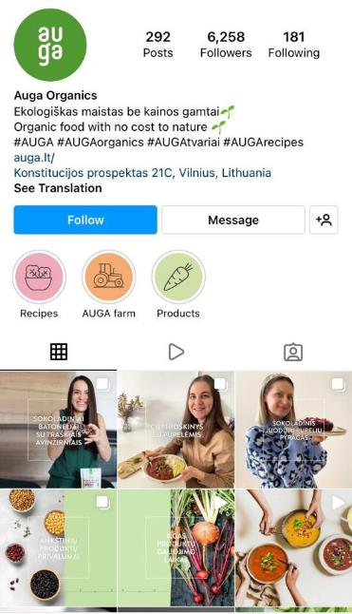

AUGA on Instagram…
Throughout their Instagram posts the language and message are consistent that they are a farm-to-fork organisation which values sustainable practices.
Their tagline
Their packaging is simple, clean and green,
containing clear and concise messaging.

Slide 60
The Importance of Branding…
Recognition in the market
Elevates the value of the business
Employee pride & satisfaction
Supports advertising
Attracts new customers
It helps both brand and company to get recognition in the market amid tough competition from other players in the industry. The logo becomes the face of the brand.
A strong brand elevates the
business's value in the market by giving leverage to the firm within the industry.
A good brand will always attract referral business as branding creates a positive impression/ trust about the company in the minds of the customers
Employees like to be associated and work for a company that has good brand value and strength in the marketplace. They take pride in sharing their company name.
Advertising and branding work as support systems and help the firm to accomplish its branding and marketing objectives in efficiently and effectively.

Slide 61
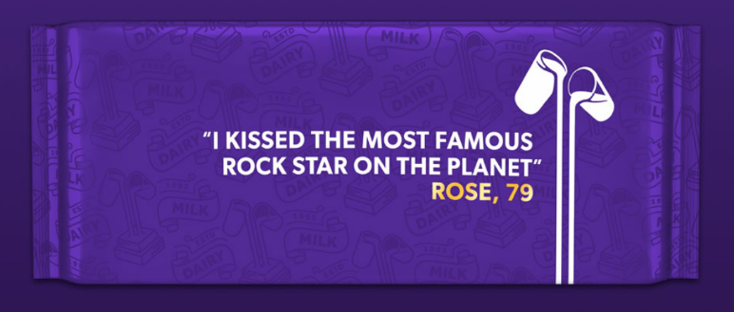
Giving the right Message!
In 2014, a study revealed that 66% of consumers felt customer-brand relationships were one-sided. Nearly 70% believed a brand’s only goal of communication was to increase profits. Since then, companies across the board have been making strides to show their softer sides— all to connect with their audiences.
Cadbury Chocolate is one such company and they are now constantly reinventing themselves through their consumers and for the wider community. Their collaboration with AgeUK is so interesting
Cadbury is currently involved in an initiative with Age-UK
“Discover the stories of amazing older people”
225,000 older people often go a whole week without speaking to anyone at all. At Age UK we support hundreds of thousands of older people every year. We know that they have so many amazing stories to tell.
We've partnered with Cadbury to encourage everyone to engage in conversations with older people.
Join us by celebrating the stories of older people you know and supporting Age UK's vital services to tackle loneliness.

Slide 62
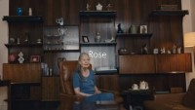
More about Rose and that Rock Star…

Slide 63
Your brand is your reputation!
1
2
3
4
5
6
Print collateral, signage, packaging
Website & online advertising
Environment
(in-store/on your platforms)
Content publishing
Sales & customer service
Internally
(with employees)
In today’s market, a successful brand must be consistent in communication and user experience. Across many applications, six of these applications are mentioned here…

Slide 64

Build your Brand…
Now that you know
WHO you want to TARGET…
What their purchasing behaviours are…
WHAT solutions/ products you want to sell them…
How you are DIFFERENT from your competitors…
What their WORRIES / PERCEPTIONS are…
What your VALUES are…
Where you want to be POSITIONED…
You can start to
BUILD YOUR BRAND

Slide 65

What is brand building?
The definition of brand building is to generate awareness about your business using strategies and campaigns aiming to create a unique and lasting image in the marketplace. Source
Branding can be broken down into three high-level phases:
Brand Strategy
Brand Identity
Brand Marketing
Positive Image
Standing out
Brand Success

Slide 66

Brand Strategy:
Your Brand Strategy maps out how you are different, trustworthy, memorable, and likeable by your ideal customer. It will convey your purpose, promises, and how you solve problems for people. This is the FIRST step you need to take when creating a brand from scratch (whether you are just starting or already established).
You can think of brand strategy as the blueprint for how you want the world to see your business. An effective and comprehensive brand strategy should include the following components/ pieces as part of the process:
Competitor
Brand
Target audience
Message & story
Brand discovery
research
voice

Slide 67

Brand Identity:
Brand Identity is how you convey this to the public with visuals, messaging, and experience. Your brand strategy will influence how you present your identity and align it with your purpose for the most impact.
Your elements of brand identity should be consistently applied across all channels. It’s the way that your business becomes recognisable. It includes your:
Print or packaging
Logo
Patterns and icons
Advertising
Website design
Content and messaging
Colours and fonts

Slide 68



Examples of Values from our Pioneering Food for Seniors Case studies
Here are a few examples of values and branding from our Good Practice guide . Each example communicates its values/message clearly and concisely through its logo and tagline…
“We grow, we cook, we deliver…because convenience shouldn’t mean compromise.”
“Senes supports professionals to reconcile the pleasure of nutrition and catering.”
“Nutritious foods in glass that are perfectly portioned for seniors.”

Slide 69
Brand Marketing:
Brand Marketing is how your businesses can highlight and bring awareness to products or services by connecting values and a voice to the right audience through strategic communication.
In 2022, the amplification of your brand image can be done effectively through various digital marketing activities:
User Experience (i.e. your website)
Email Marketing
Social Media Marketing
SEO & Content Marketing
Paid Advertising (PPC)

Slide 70

Stay Innovative…
Innovative products and solutions that can adapt to con­sumer behaviour and new tech­nolo­gies while main­tain­ing a strong cus­tomer focus is essen­tial to great mar­ket­ing.
Hopefully, through this course, you are already getting an insight into senior consumers’ needs via our research tactics and understand more about how to innovate and brand your offerings accordingly.
This subject will be expanded upon in Module 6.

Slide 71
4
Links to Resources

Slide 72
Some additional resources for you…
This paper explores ways to segment the senior market through product formats and derived 8 segmentation bases. Understanding heterogeneity among elderly consumers: an evaluation of segmentation approaches in the functional food market | Nutrition Research Reviews | Cambridge Core
This report discusses the findings of the market research yielded during the InCluSilver Project Etude de marché (inclusilver.eu)
This is a Podcast on How UNiTE Food is welcoming new people into wellness and their Marketing Strategy https://snacknation.com/blog/unite-food-clara-paye/
This Podcast discusses gives tips and insights into how to build a recognised food brand with very limited budget https://snacknation.com/blog/162-how-to-build-an-ethical-brand-with-zero-marketing-budget-with-the-perfect-granola-founder-michele-liddle/

Slide 73
Thank You for completing Module 3. Please continue your learning journey with us as we explore New Product Development in Module 4!
www. innovatingfoodforseniors.eu

